Slide 1
Lecture 18 objectives
Chapter 12- continued-
Provide examples of how cells deal with common carcinogens
Be able to explain the link between types of mutations and likely defects in the DNA damage response and repair pathways
Be able to explain how spindle geometry influences genomic stability

Slide 2
Cells deploy mechanisms to protect against carcinogens
DNA damage recognition and response
replication proofreading (wrong base incorporated)
MMR: Mismatch repair (replication ‘slipping’)
→ BER: Base excision repair (bases damaged by endogenous ROS)
→ NER: nucleotide excision repair (bases damaged by large adducts)
Glutathione S-transferase enzymes: Chemically reactive metabolic byproducts (ultimate carcinogens) detoxified by addition of glutathione moiety
Physical shields to limit exposure

Slide 3
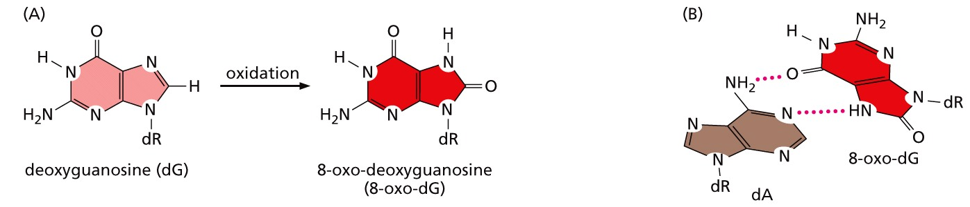
Non-replicative DNA damage
Reactive oxygen species (ROS): Intermediates are highly reactive and form covalent bonds to other molecules- DNA included
Can induce:
Altered and abasic sites
single and double strand breaks
DNA-protein crosslinks
Result in new DNA base pairs

Slide 4
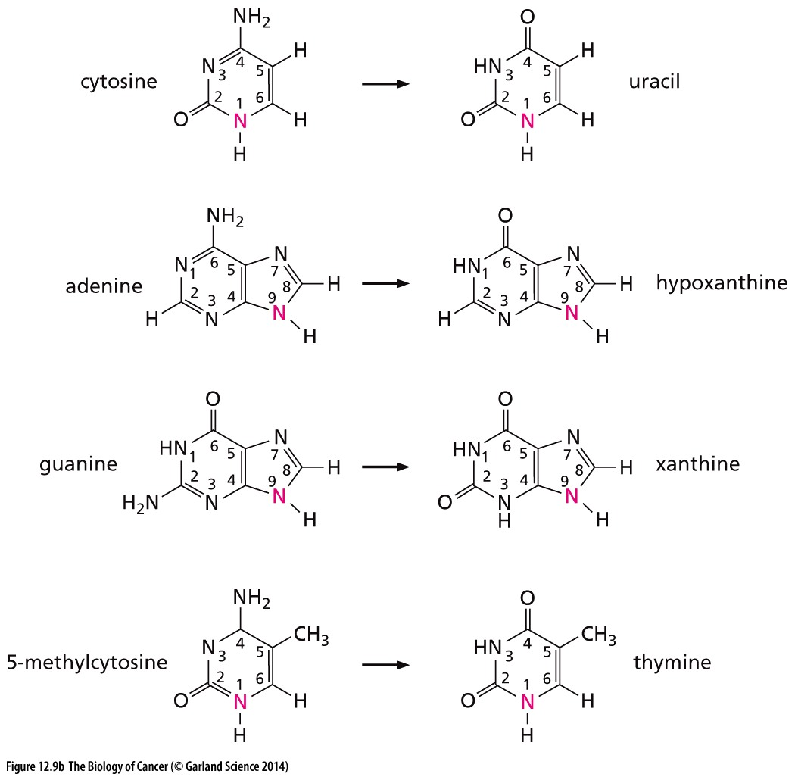
Non-replicative DNA damage
Deamination and oxygenation changes a base
Guanine:
:Adenine
→ Aberrant bases may result in new base-pairs during next round of replication

Slide 5
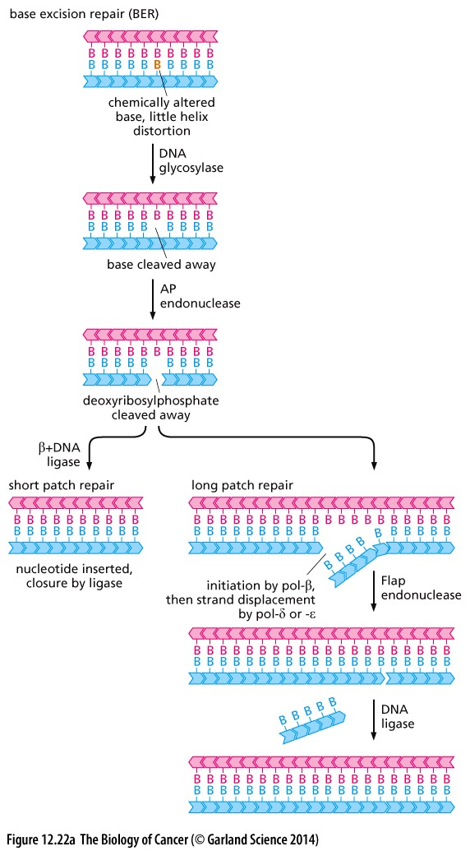
Base excision repair removes damaged bases
EX: deamination will damage a base
Damaged base is recognized by a specialized enzyme: APE

Slide 6
New polymerization uses the undamaged template strand
Single strand gap is filled in by DNA polymerase
Sugar backbone is sealed by DNA ligase

Slide 7
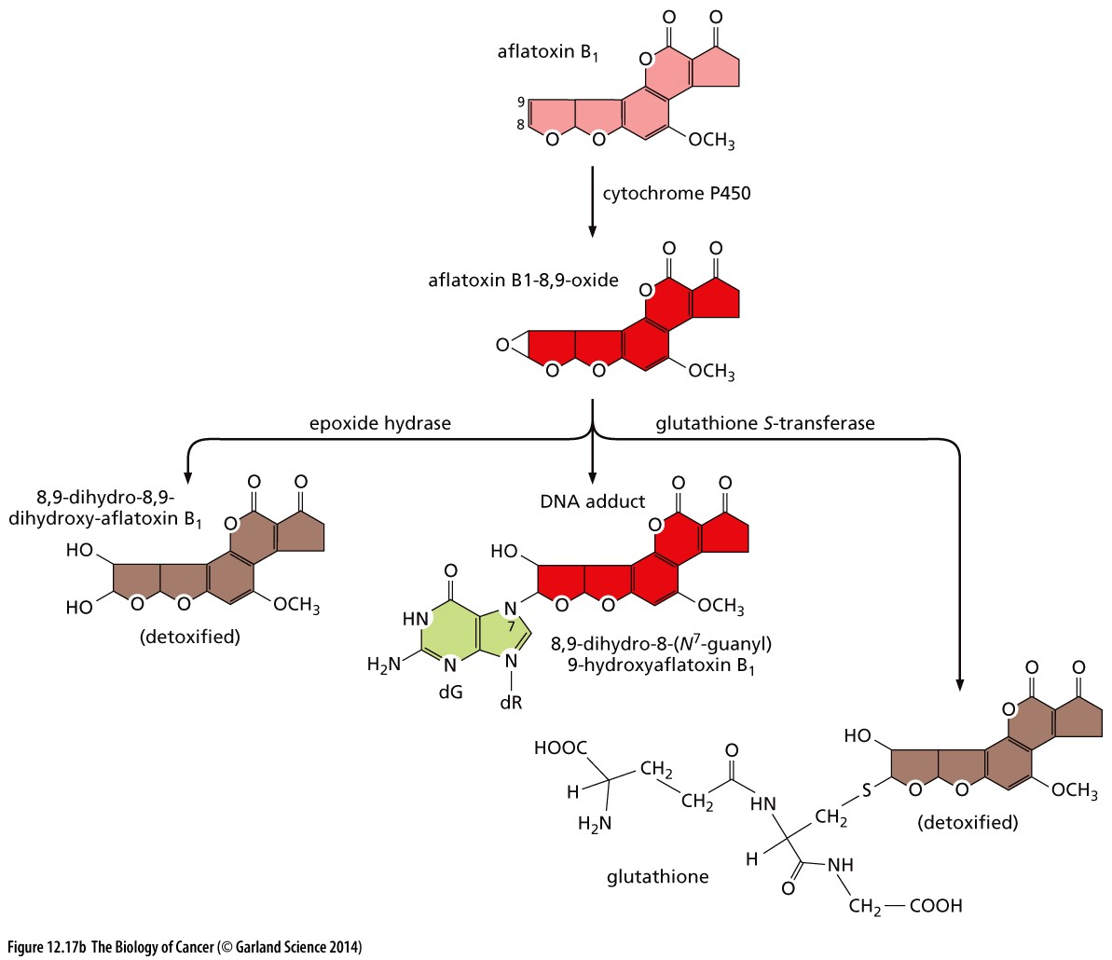
Large DNA adducts
Metabolic intermediates can react with bases
→ Large adducts get in the way of replication machinery

Slide 8
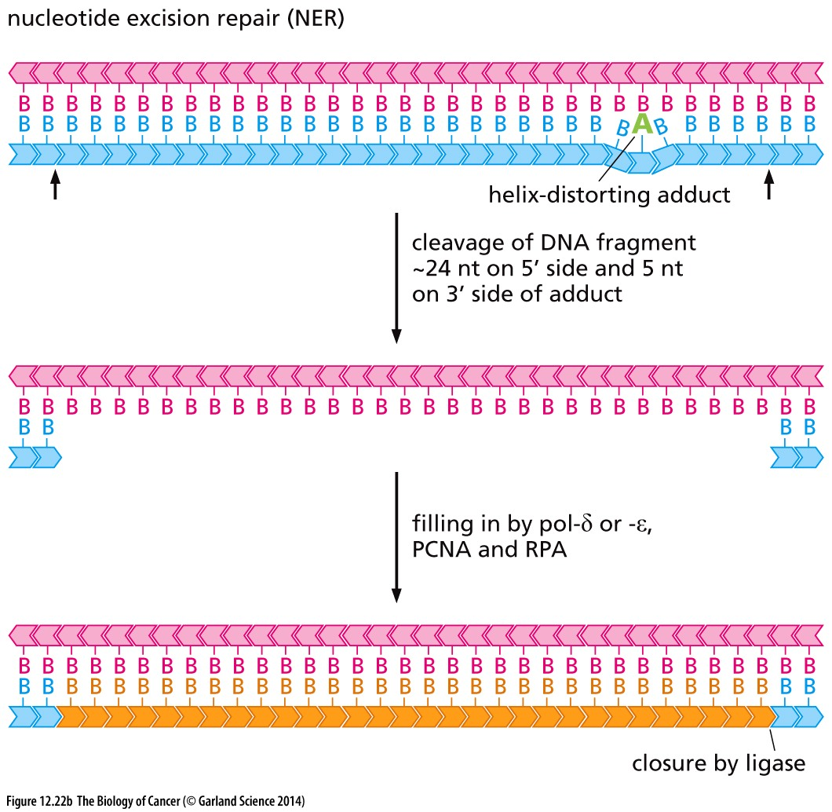
Large DNA adducts are repaired by nucleotide excision repair
Distortion of the DNA helix recruits specialized nucleases that cut out a 29 nucleotide piece that flanks the damage
Why 29 nucleotides?
Why is more sequence removed upstream then downstream?
DNA polymerase fills the gap

Slide 9
2. Chemical defense against damage
Metabolic carcinogens are neutralized
Glutathione S-transferase enzymes (GSTs) link glutathione to carcinogens (that are electrophilic)
Glutathione tag marks them for metabolism and excretion

Slide 10
Summary: cellular metabolites can alter DNA structure and sequence
Depurination & depyrimidination removes a base
Deamination changes a base (removal of an amine group)
Bulky adducts compromise base pairing
Double strand nature of DNA is protective, even so…
can happen in non-proliferating cells
Change in the genomic sequence may impact RNA translation
WILL induce permanent genomic changes if not repaired before next round of replication
Mutations in DNA damage recognition or response proteins are common in cancer,
GST expression is dramatically suppressed in many cancer contexts → increased rate of mutagenesis

Slide 11
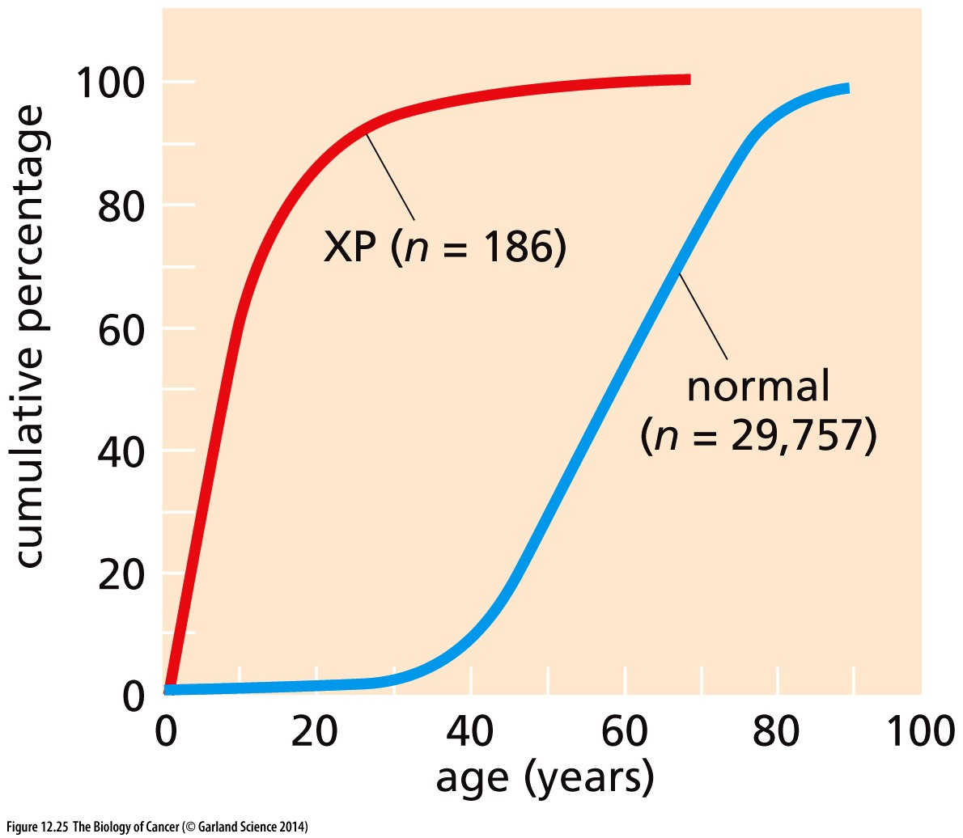
Defects in repair mechanisms lead to cancer susceptibility
Xeroderma Pigmentosa (XP) patients are extremely sensitive to UV radiation
UV-induced crosslinks are typically repaired by
Homozygous inactivation of both alleles of any of 8 different genes leads to 2,000-fold increase of skin cancer
How can all 8 genes be essential, but loss of only one causes cancer?
7 are components of a large multiprotein NER complex, 1 is pol-η
NER

Slide 12
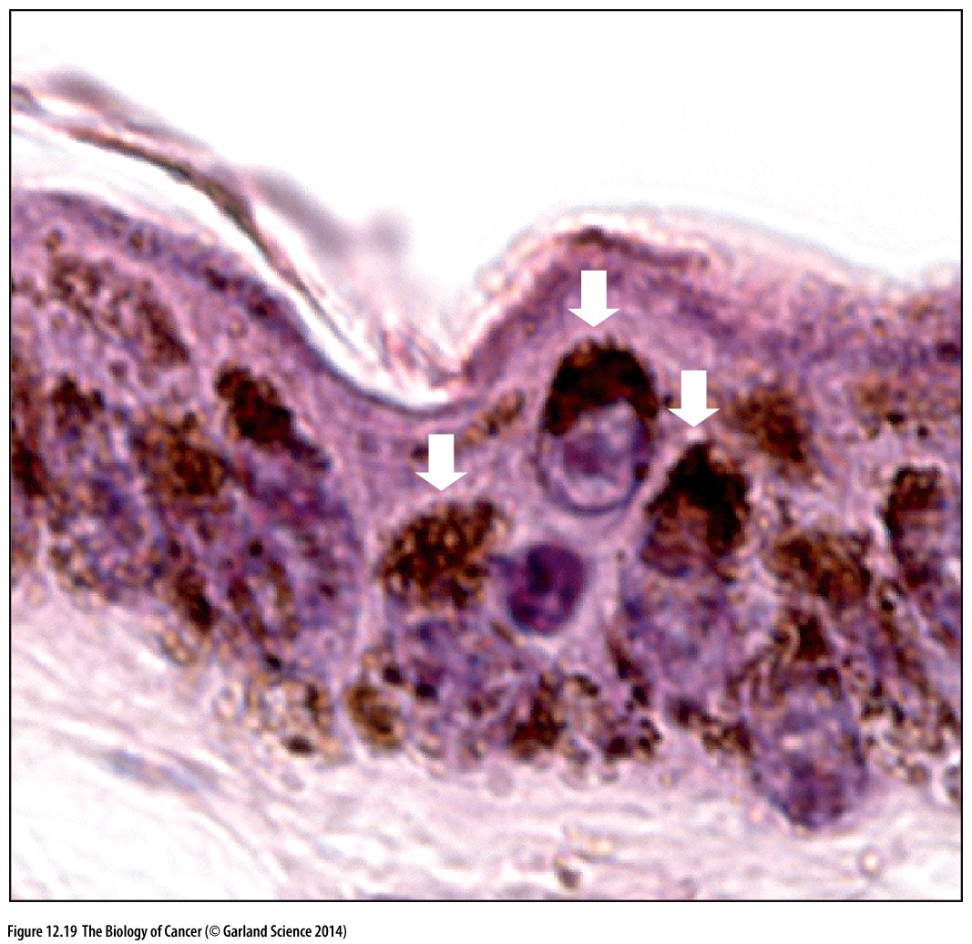
3. Cells actively protect against mutagen attack
Melanin → pigment shields against UV damage
Expressed by melanocytes and passed to keritinocytes
positioned where it can best protect the nuclear DNA
>4-fold decrease in UV damage
No similar protection exists for X rays or cosmic rays

Slide 13
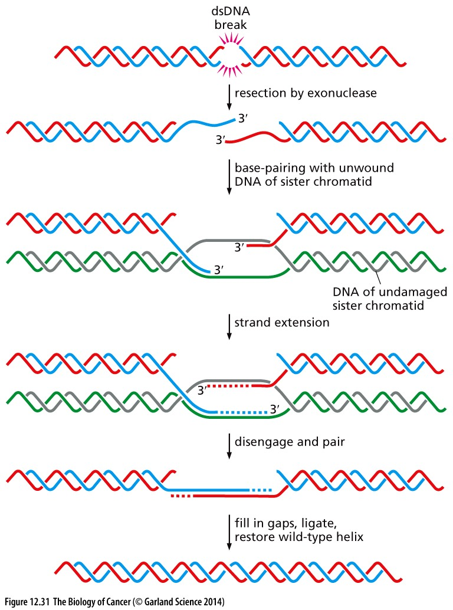
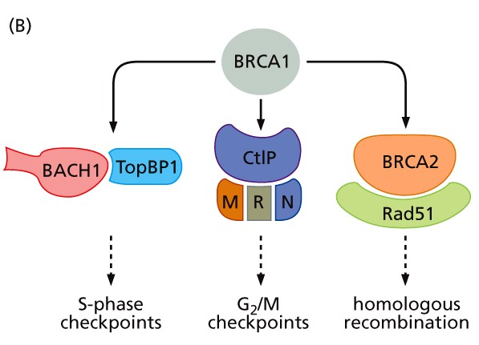
Defects in double strand break repair can cause s-CIN
Homologous recombination (HR or HDR) is used when a replicated sister is available as a template

Slide 14
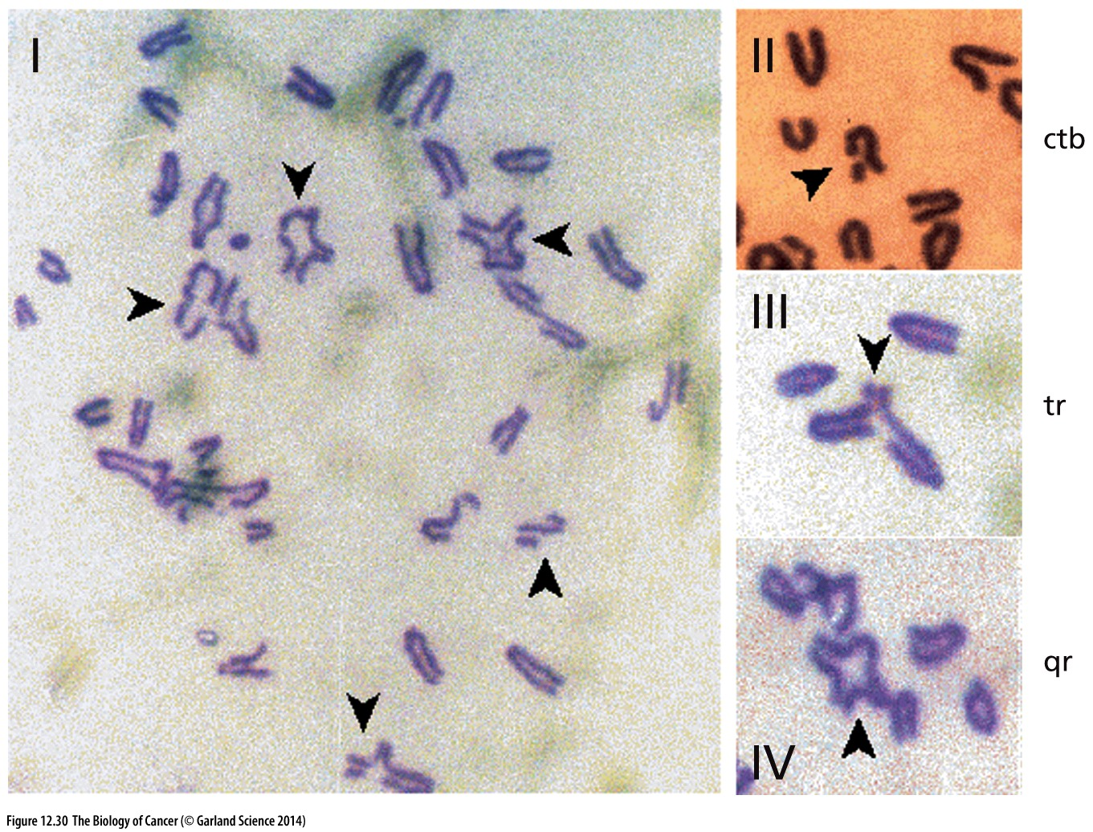
Failure to complete HR has disastrous consequences
Structural instability (s-CIN):
Chromosome fusions
Breaks
Triradials
Quadriradials
NHEJ used instead
No repair
Partial HR

Slide 15
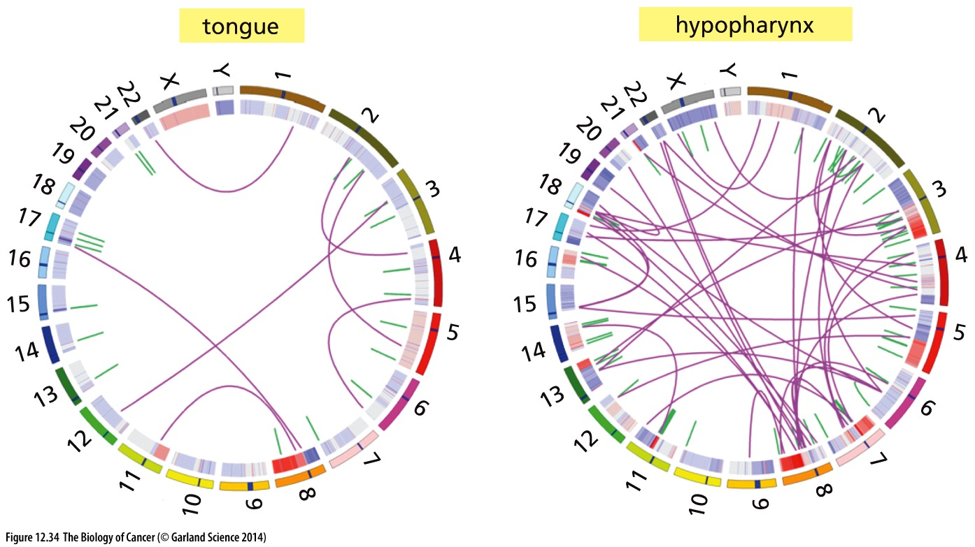
Degree of s-CIN varies among cancers
Might degree of translocations be indicative or which DDR pathway is altered?
Are the resulting translocations passenger or driver mutations?

Slide 16
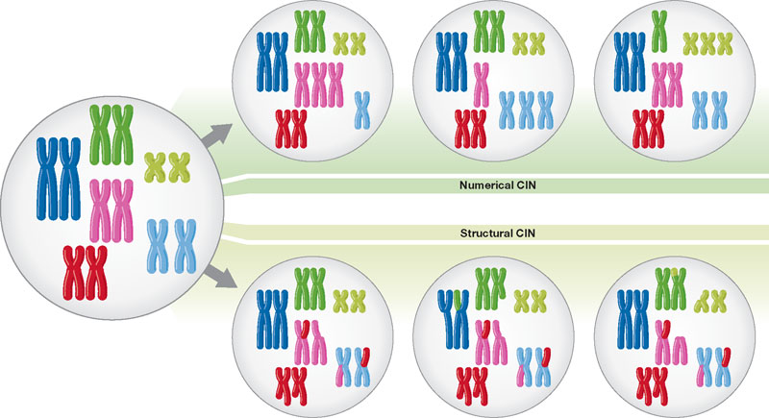
Karyotype changes are prevalent in cancer
2 main types of chromosome instability that present as karyotype abnormalities:
Both types of instability are often present together in advanced cancers, but the underlying causes are distinct
Changes in chromosome number (n-CIN)
Monosomy, trisomy, etc
Changes in chromosome structure (s-CIN)
Translocations, large deletions or amplifications, etc

Slide 17
Changes in chromosome number help generate tumor heterogeneity
A single erroneous chromosome segregation event will cause aneuploidy
Continuous defects in chromosomes segregation in each cell division causes n-CIN
Normal cells do not tolerate aneuploidy and will activate p53 checkpoint function to promote arrest in G1 of the next cell cycle → n-CIN cancers often also have lose p53 function
→ rates of 1 mis-segregation event every 1 to 5 cell divisions quickly leads to very heterogeneous cancer cell population
Will all cancers with nCIN be highly heterogeneous?

Slide 18
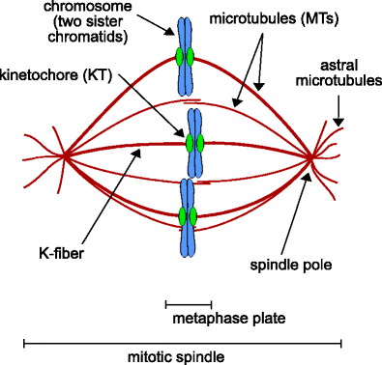
Underlying defects in the process of mitotic segregation cause n-CIN
Chromosome bi-orientation is critical to proper mitotic segregation
Spindle assembly checkpoint(SAC) monitors chromosome attachment and alignment

Slide 19
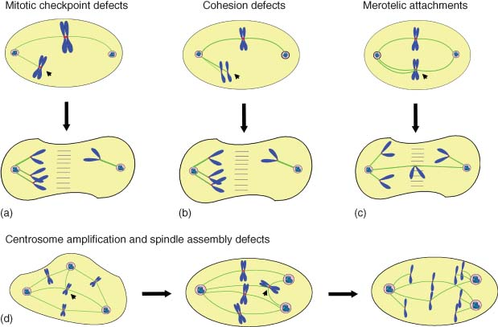
Underlying defects in the process of mitotic segregation cause n-CIN
Defects in the SAC, or cohesion between replicated chromosomes causes catastrophic segregation errors → these cells are not viable
Unlikely to be common mechanisms in generation n-CIN in cancer
Anaphase before full chromosome attachment
Attached but unable to bi-orient

Slide 20
Merotelic attachments are the major underlying cause of n-CIN in cancer
Merotelic attachments happen when a single kinetochore attaches to microtubules from BOTH spindle poles
This satisfies the spindle assembly checkpoint : full attachment + tension → chromosomes align normally
Cells with merotely are allowed to complete cell division
‘tug of war’ with chromosome may result in a mis-segregation

Slide 21
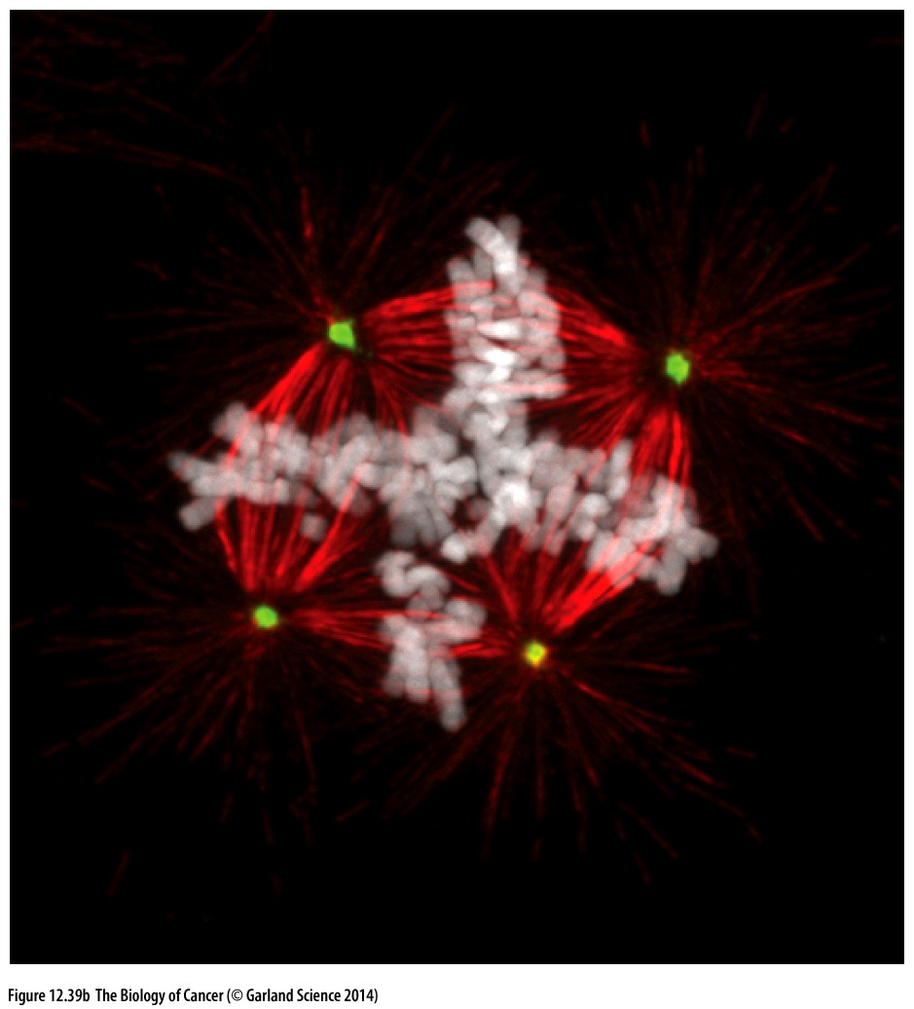
Disruptions in spindle geometry or centromere/kinetochore regulation can lead to merotely
Biorientation depends on:
2 centromeres that are juxtaposed
sister chromosomes cohesed and facing opposite directions
2 spindle poles
2 anchor points for chromosomes to attach
Cancer cells frequently have extra spindle poles (centrosomes)

Slide 22
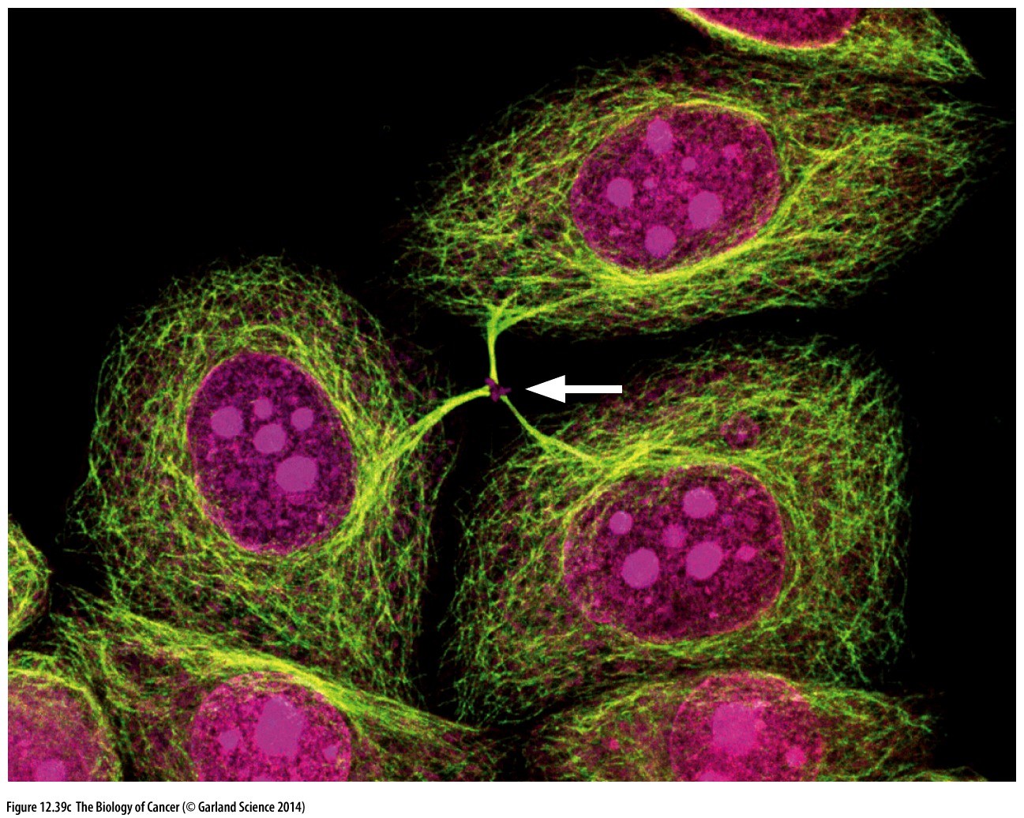
Multipolar divisions lead to cell death
A multipolar spindle that proceeds through a multipolar division will form 3 (or more cells) that lack many chromosomes → non-viable

Slide 23
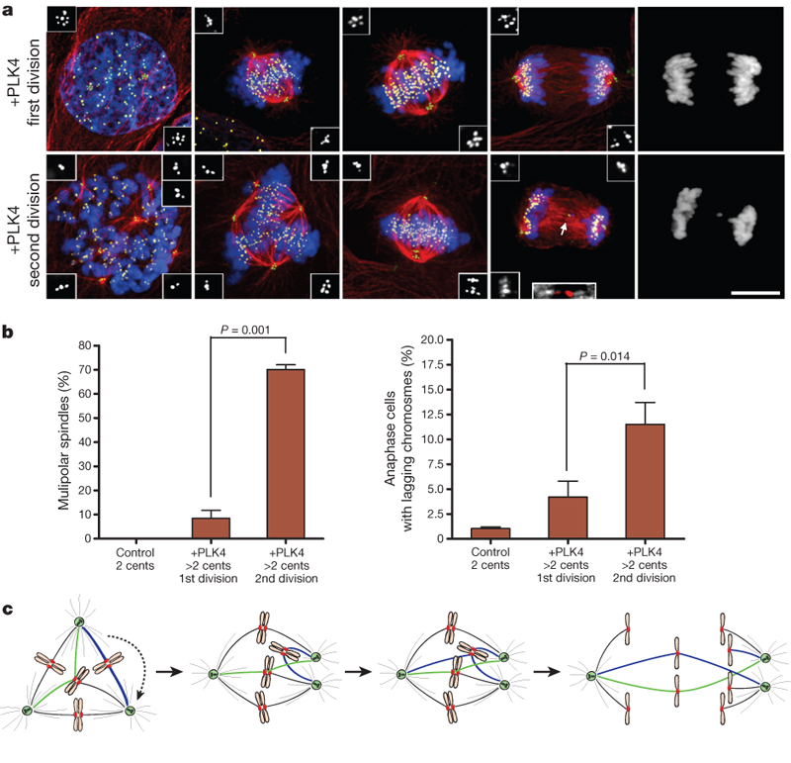
Multipolar spindle intermediates promote merotely
To circumvent this cancer cells cluster extra centrosomes to form bipolar spindles and complete bipolar divisions

Slide 24
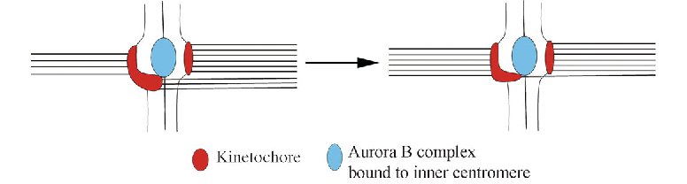
Changes at the centromere can promote merotely
NORMAL cells form merotelic attachments!
BUT these mal-attachments are removed and replaced by proper attachments before anaphase onset → remember SAC doesn’t detect these and won’t wait for correction
Defects in centromere structure may allow more merotelics to form
Defects in error correction mechanisms may prevent efficient repair

Slide 25
Changes at the centromere can promote merotely
NORMAL cells form merotelic attachments!
BUT these mal-attachments are removed and replaced by proper attachments before anaphase onset → remember SAC doesn’t detect these and won’t wait for correction
Defects in centromere structure may allow more merotelics to form
Defects in error correction mechanisms may prevent efficient repair
Understanding molecules and pathways involved may inform therapeutic approaches

